Slide 1


Rendall & Rittner Limited
Tuesday 1st March 2016
19:00-20:30

Slide 2
Meeting Agenda
R&R Management Update
  Staffing introductions and structure
  Projects update
  Financials
  Summary
  Questions & Feedback

Slide 3

Managing Director
Richard Daver
Senior Property Manager/Team Leader
Harry Fenner
Assistant Property Manager
Hayley Law
Mike Keam
Development Manager
Front House Manager
Sonata Akhtar
Facilities Manager
Mark Smith
Projects Manager
Barry Maguire
Shift Leader
Ulia Pitaru
Day Concierge
Mo Adams
Night Concierge
Stephen Desbonne
Internal Cleaner
Victoria Oltavaro
Maintenance Operative
Szabolk Toth
Day Concierge
Nadia Toma
Night Concierge
Steve Buabasah
Internal Cleaner
Francisco Riva
Maintenance Operative
Mark Paul
Day Concierge
Victor Risco
Night Concierge
Stephano Penrhyn
Internal Cleaner
Ade Lasisi
Day Concierge
Dominic McWilliams
Night Concierge
Istvan Toth
Internal Cleaner
Sirley Mendonca
Internal Cleaner
Renan Sousa
Senior Front of House Officer
David Trigg
Estate Operative
Antonio Pinto
Internal Cleaner
Daniel Sledz
Estate Operative
Tony Schifano
Front of House Officer (Weekend)
Sebastian Madej
Front of House Officer
Matthew Tween
Estate Operative
Mansour Katagoley

Slide 4
Major Redecorations
Lanson Complete - Carpets to be replaced
Burnelli Complete
Hawker Painting and Carpets to take place 2016
Howard Complete ( bar external tiles)
Warwick Complete
Oswald Complete
Eustace Complete
Centurion Complete
Horace Painting and Carpets to take place 2017

Slide 5
Security Doors Project
The Ballot Results

Slide 6
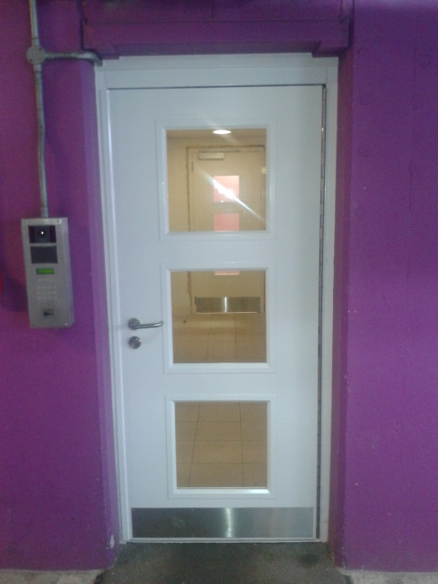
Security Doors Project

Slide 7
Considerations
Redundant equipment
Risk of failure
Theft and break ins
Future proofing the system
Current finances doesn’t allow for works to proceed without additional funding

Slide 8
Options
Option 1.
Change all security doors now and upgrade access control & Intercom system at a later date.
Option 2.
Change all security doors and upgrade Access control & Intercom system at the same time.
Option 3
Change all security doors and upgrade Access control now, but recycle Intercom system and utilise parts in order so cost can be controlled.

Slide 9
Summary
Security Doors Support Equipment
 |  |  |  |  | Total incl VAT
ASSA ABLOY | 204,342.40 | Couldn’t offer piano hinge spec or ballistic glass. | ENSPIRE SECURITY | 522,325.20 | 726,667.60
BRADBURY | 311,217.20 |  | K.I.D.D SECURITY | 438,219.00 | 749,436.20
SUNRAY DOORS | 376,400.00 | Couldn’t offer PASS24 only SR1/2 or 3 | UNABLE TO QUOTE
ABSOLUTE SHUTTERS | 288,300.60 |  | UNABLE TO QUOTE
CORNERSTONE | £270,764.40 |  | CORNERSTONE | 440,321.20 | 711,085.60

Slide 10
Cost Breakdown
Access Control £313,225.60
Fobs £42,840.00
Intercom Recycling £18,280.00
Monitoring System £22,442.00
Fibre Backbone £43,533.60
Security doors £270,764.40
Total incl VAT £711,085.60

Slide 11
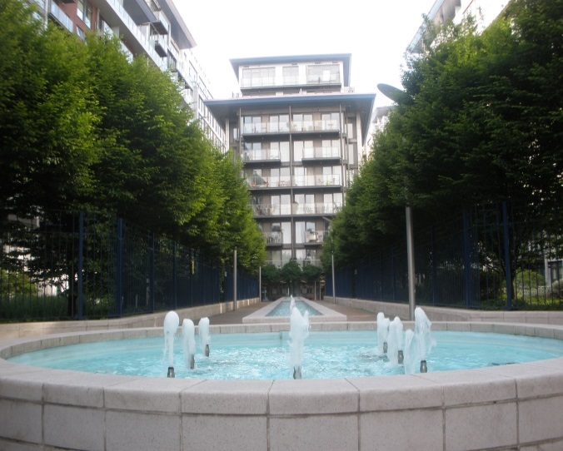
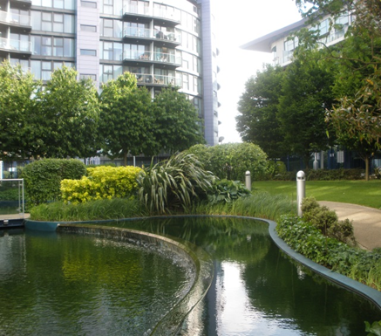
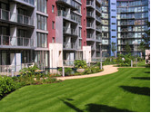
Water Features Project
Brief Scope of Works
(Lighting, pathways, soak away systems, re-lining)
Preparation to date (Consultants have been instructed on tendering process) prices received to date: 752,886.00, 886,300.00 & 794,313.70 incl VAT
S20 process
Schedule/scope of works to be received. (winter months) (balcony lifts) ( 4 phased approach, 3 weeks per area)

Slide 12
LED Lighting
Area Reviewed – Carp Park CP1/CP2
- All buildings
Car Park cost £109,525.00 incl VAT
£87,950 to be covered by Berkeley
£21,575 to be covered by Car Park reserves
Current consumption for the carpark per annum currently sits at circa £9,300 per month, new solution is estimated to reduce consumption to circa £2,600 per month.
ROI – 13.8 months

Slide 13
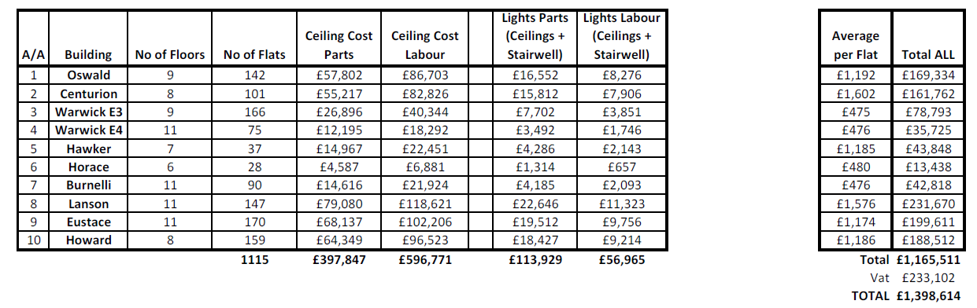
LED Lighting
Buildings

Slide 14
Pipelined projects for CBW
Sky Q installation
Phone signal
E communications/Billing and the benefits that come with it.

Slide 15
Financial Update
  2015:
  Circa 1% deficit in respect of Fairhold Artemis blocks
  Circa 3% Surplus in respect of Berkeley Homes
  Circa 5% Surplus in respect of the Estate
  The above are subject to allocation review and final audit.

Slide 16
HOW IS 2016 LOOKING Financially SO FAR?
Contract reviews have been carried out and prices to be held for a second year, should their services be chosen again.
Contract savings and service level increase in regards to TV Communication.

Slide 17
Our targets and visions for Chelsea Bridge Wharf

Slide 18
Service Charge Increases Explained
 |  | Budgeted amount |  |  | Actual
2009 |  | 2,835,411 |  |  | 2,535,763.85
2010 |  | 2,885,045 |  |  | 2,517,267.60
2011 |  | 2,997,677 |  |  | 2,717,210.07
2012 |  | 2,812,392 |  |  | 2,553,582.19
2013 |  | 2,903,228 |  |  | 2,560.505.22
2014 |  | 3,019,357 |  |  | 2,998,400.00
2015 |  | 3,154,642 |  |  | Unknown as of yet
2016 |  | 3,314,009 |  |  | Unknown as of yet
Summary |  | 2.4% increase per annum over 7 years

Slide 19
 | 2009 | 2,835,411
 | 2010 | 2,885,045
 | 2011 | 2,997,677
 | 2012 | 2,812,392
 | 2013 | 2,903,228
R&R Budget | 2014 | 2,736,857
R&R Budget | 2015 | 2,872,142
R&R Budget | 2016 | 3,031,509
 | 2009 | 2,835,411
 | 2010 | 2,885,045
 | 2011 | 2,997,677
 | 2012 | 2,812,392
 | 2013 | 2,903,228
R&R Budget | 2014 | 2,634,857
R&R Budget | 2015 | 2,770,142
R&R Budget | 2016 | 2,929,509

Slide 20
What Would You Like To See Happen?
Questions/Ideas/Comments ?

